Slide 1
Sets Project Presentation
Dylan Soemitro, Mujie Wang, Xiaorong Wang

Slide 2
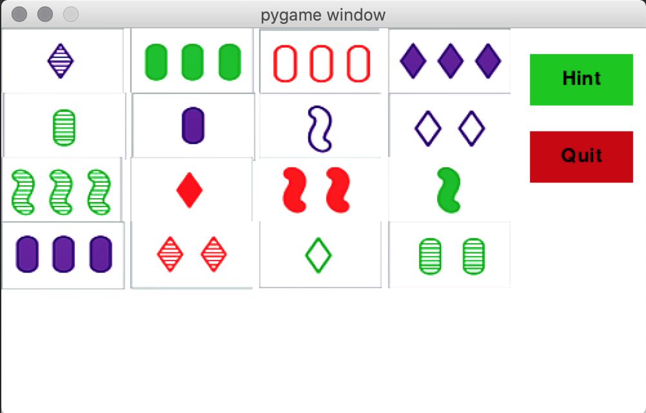
Program Demo

Slide 3
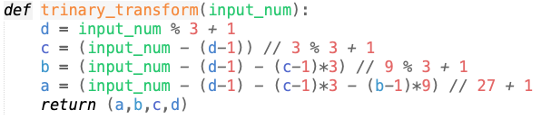
Code display
Use natural number to encode a tuple:
Each natural number n in 0~80 is corresponds to a unique tuple (a, b, c, d), where
n = 27*(a-1) + 9*(b-1) + 3*(c-1) + (d-1)
Notes:
Part of our code that are most relevant/most relevant function
Data structure
Math part?? Count as algorithm??

Slide 4
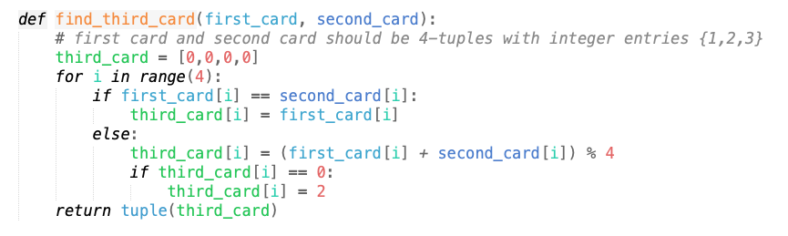
Code display
“Graph” - every pair of nodes is connected by an edge. Every edge is labeled by a unique node.
This structure is realized by the following function:
Notes:
Part of our code that are most relevant/most relevant function
Data structure
Math part?? Count as algorithm??

Slide 5
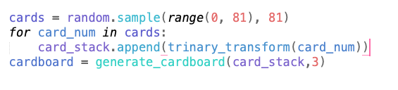
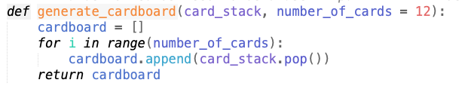
Code display
Stack (implemented upon list)
Easier to keep track of the cards left
Notes:
Part of our code that are most relevant/most relevant function
Data structure
Math part?? Count as algorithm??

Slide 6
Challenges
Pygame package
Card images/using photoshop
Inexperience with pygame
Connecting codes
Talking through the codes
modify /debug each other’s codes
Logistics

Slide 7
Future step
Testing various score systems
Saving highscores
Modifying the game into a two player game (offline/online)
Competition mode
Work-together mode
More user choices available
“No set mode”

Slide 8
References:
https://geekandsundry.com/the-card-game-that-puzzled-mathematicians-for-decades/

